Slide 1
Chapter 5: CPU Scheduling

Slide 2
Chapter 5: CPU Scheduling
Basic Concepts
Scheduling Criteria
Scheduling Algorithms
Thread Scheduling
Multiple-Processor Scheduling
Operating Systems Examples
Algorithm Evaluation

Slide 3
Objectives
To introduce CPU scheduling, which is the basis for multiprogrammed operating systems
To describe various CPU-scheduling algorithms
To discuss evaluation criteria for selecting a CPU-scheduling algorithm for a particular system

Slide 4
Basic Concepts
Maximum CPU utilization obtained with multiprogramming
CPU–I/O Burst Cycle – Process execution consists of a cycle of CPU execution and I/O wait
CPU burst distribution

Slide 5
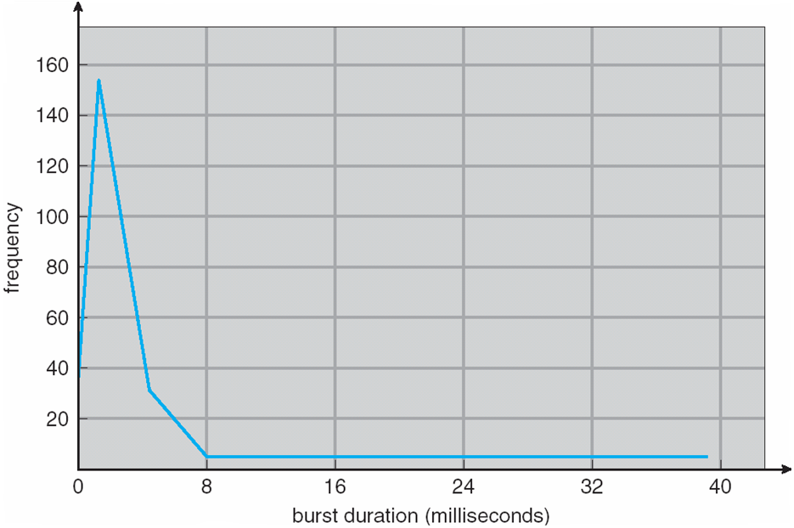
Histogram of CPU-burst Times

Slide 6
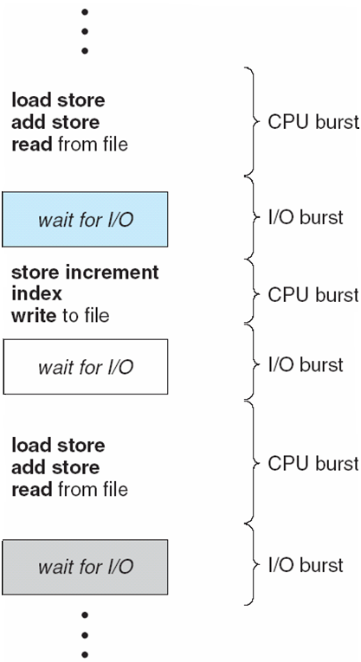
Alternating Sequence of CPU And I/O Bursts

Slide 7
CPU Scheduler
Selects from among the processes in memory that are ready to execute, and allocates the CPU to one of them
CPU scheduling decisions may take place when a process:
1. Switches from running to waiting state
2. Switches from running to ready state
3. Switches from waiting to ready
Terminates
Scheduling under 1 and 4 is nonpreemptive
All other scheduling is preemptive

Slide 8
Dispatcher
Dispatcher module gives control of the CPU to the process selected by the short-term scheduler; this involves:
switching context
switching to user mode
jumping to the proper location in the user program to restart that program
Dispatch latency – time it takes for the dispatcher to stop one process and start another running

Slide 9
Scheduling Criteria
CPU utilization – keep the CPU as busy as possible
Throughput – # of processes that complete their execution per time unit
Turnaround time – amount of time to execute a particular process
Waiting time – amount of time a process has been waiting in the ready queue
Response time – amount of time it takes from when a request was submitted until the first response is produced, not output (for time-sharing environment)

Slide 10
Scheduling Algorithm Optimization Criteria
Max CPU utilization
Max throughput
Min turnaround time
Min waiting time
Min response time

Slide 11
First-Come, First-Served (FCFS) Scheduling
Process Burst Time
P₁ 24
P₂ 3
P₃ 3
Suppose that the processes arrive in the order: P₁ , P₂ , P₃ The Gantt Chart for the schedule is:
Waiting time for P₁ = 0; P₂ = 24; P₃ = 27
Average waiting time: (0 + 24 + 27)/3 = 17
P₁
P₂
P₃
0
24
27
30

Slide 12
FCFS Scheduling (Cont.)
Suppose that the processes arrive in the order:
P₂ , P₃ , P₁
The Gantt chart for the schedule is:
Waiting time for P₁ = 6; P₂ = 0; P₃ = 3
Average waiting time: (6 + 0 + 3)/3 = 3
Much better than previous case
Convoy effect short process behind long process
P₂
P₃
P₁
0
3
6
30

Slide 13
Shortest-Job-First (SJF) Scheduling
Associate with each process the length of its next CPU burst. Use these lengths to schedule the process with the shortest time
Two schemes:
Non preemptive – once CPU given to the process it cannot be preempted until completes its CPU burst.
Preemptive – if a new process arrives with CPU burst length less than remaining time of current executing process, preempt. This scheme is know as the Shortest-Remaining-Time-First (SRTF).
SJF is optimal – gives minimum average waiting time for a given set of processes
The difficulty is knowing the length of the next CPU request

Slide 14
Example of Non Preemptive SJF
Process Arrival Time Burst Time
P₁ 0.0 6
P₂ 2.0 8
P₃ 4.0 7
P₄ 5.0 3
SJF scheduling chart
Average waiting time = (3 + 16 + 9 + 0) / 4 = 7
_{Average turnaround time = 13}
P₄
P₁
P₃
P₂
0
3
9
16
24

Slide 15
Exercise non Preemptive SJF
Process Arrival Time Burst Time
P₁ 0.0 7
P₂ 2.0 4
P₃ 4.0 1
P₄ 5.0 4
P₁
P₃
P₂
P₄
0
3
7
8
12
16

Slide 16
Exercise non Preemptive SJF
Average waiting time = (0 + 6 + 3 + 7)/4 =4
Average Turnaround time = 8
P₁
P₃
P₂
P₄
0
3
7
8
12
16

Slide 17
Determining Length of Next CPU Burst
Can only estimate the length
Can be done by using the length of previous CPU bursts, using exponential averaging

Slide 18
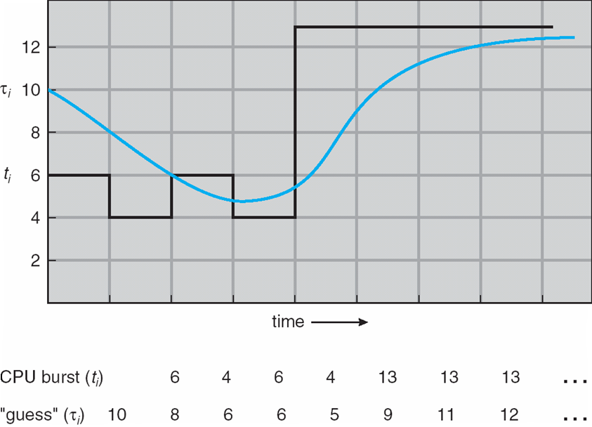
Prediction of the Length of the Next CPU Burst

Slide 19
Examples of Exponential Averaging
α =0
τ_{n+1} = τ_{n}
Recent history does not count
α =1
τ_{n+1} = α t_{n}
Only the actual last CPU burst counts
If we expand the formula, we get:
τ_{n+1} = α t_{n}+(1 - α)α t_{n} -1 + …
+(1 - α )^{j} α t_{n} _{-j} + …
+(1 - α )^{n +1} τ₀
Since both α and (1 - α) are less than or equal to 1, each successive term has less weight than its predecessor

Slide 20
Example of Preemptive SJF or SRTF
Process Arrival Time Burst Time
P₁ 0.0 7
P₂ 2.0 4
P₃ 4.0 1
P₄ 5.0 4
SJF (preemptive)
Average waiting time = (9 + 1 + 0 +2)/4 - 3
P₁
P₂
P₃
P₂
P₄
P₁
0
2
4
5
7
11
16

Slide 21
Exercise Preemptive SJF or SRTF
Process Arrival Time Burst Time
P₁ 1 4
P₂ 2 4
P₃ 3 5
P₄ 4 8
Average waiting time = 4.75
Average Turnaround time = 10
P₁
P₂
P₃
P₂
P₄
P₁
0
2
4
5
7
11
16

Slide 22
Exercise Preemptive SJF or SRTF
Process Arrival Time Burst Time
P₁ 0 8
P₂ 1 4
P₃ 2 8
P₄ 3 5
Avg wt= ((10 - 1) + (1 - 1) + (17 - 2) + (5 - 3))/4 = 26/4 = 6.5 ms
Non preemptive = 7.75ms
P₁
P₂
P₃
P₂
P₄
P₁
0
2
4
5
7
11
16

Slide 23
Priority Scheduling
A priority number (integer) is associated with each process
The CPU is allocated to the process with the highest priority (smallest integer ≡ highest priority)
Preemptive
Nonpreemptive
SJF is a priority scheduling where priority is the predicted next CPU burst time
Problem ≡ Starvation – low priority processes may never execute
Solution ≡ Aging – as time progresses increase the priority of the process

Slide 24
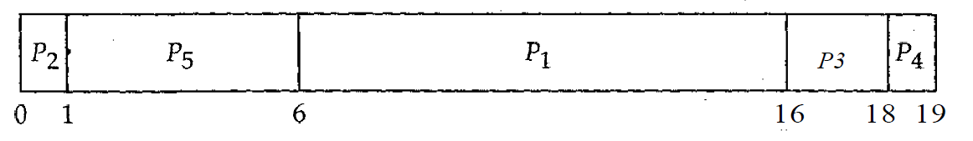
Example for Priority scheduling
Process Burst Time Priority
P₁ 10 3
P₂ 1 1
P₃ 2 3
P₄ 1 4
P5 5 2
P₁
P₂
P₃
P₂
P₄
P₁
0
2
4
5
7
11
16
Average Waiting time = 8.2 ms

Slide 25
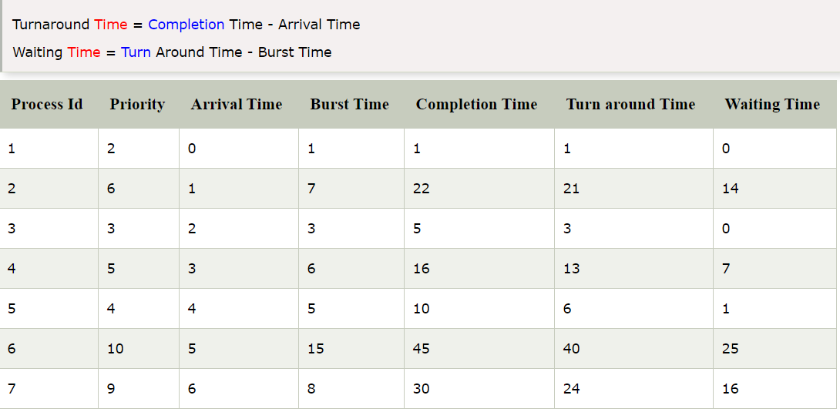
Preemptive priority scheduling

Slide 26
Round Robin (RR)
Each process gets a small unit of CPU time (time quantum), usually 10-100 milliseconds. After this time has elapsed, the process is preempted and added to the end of the ready queue.
If there are n processes in the ready queue and the time quantum is q, then each process gets 1/n of the CPU time in chunks of at most q time units at once. No process waits more than (n-1)q time units.
Performance
q large ⇒ FIFO
q small ⇒ q must be large with respect to context switch, otherwise overhead is too high

Slide 27
Example of RR with Time Quantum = 4
Process Burst Time
P₁ 24
P₂ 3
P₃ 3
The Gantt chart is:
Typically, higher average turnaround than SJF, but better response
P₁
P₂
P₃
P₁
P₁
P₁
P₁
P₁
0
4
7
10
14
18
22
26
30

Slide 28
Example: RR with Time Quantum = 20
Process Burst Time
P₁ 53
P₂ 17
P₃ 68
P₄ 24
The Gantt chart is: Typically, higher average turnaround than SJF, but better response.
P₁
P₂
P₃
P₄
P₁
P₃
P₄
P₁
P₃
P₃
0
20
37
57
77
97
117
121
134
154
162

Slide 29
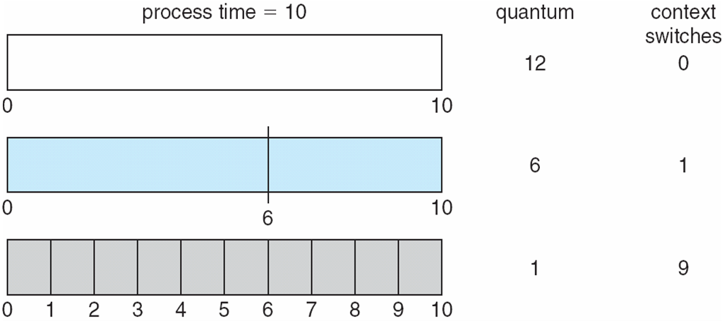
Time Quantum and Context Switch Time

Slide 30
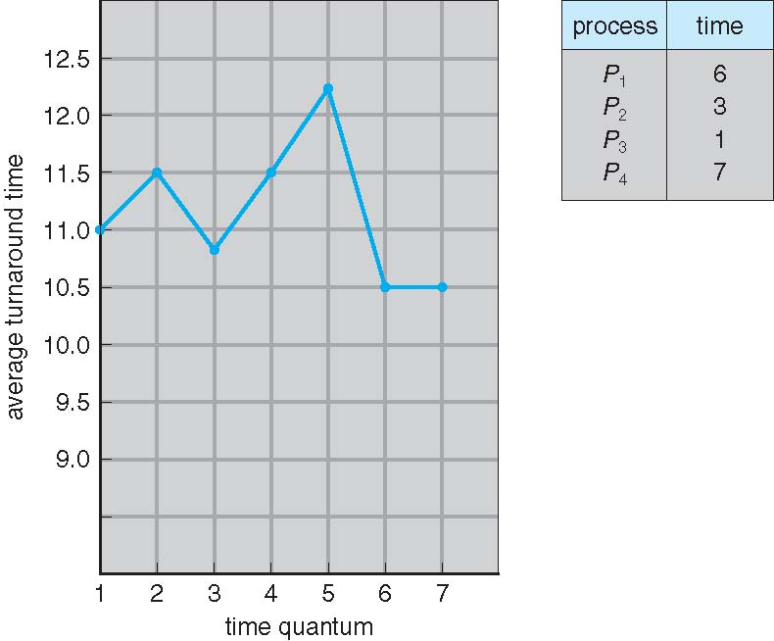
Turnaround Time Varies With The Time Quantum

Slide 31
Multilevel Queue
Ready queue is partitioned into separate queues: foreground (interactive) background (batch)
Each queue has its own scheduling algorithm
foreground – RR
background – FCFS
Scheduling must be done between the queues
Fixed priority scheduling; (i.e., serve all from foreground then from background). Possibility of starvation.
Time slice – each queue gets a certain amount of CPU time which it can schedule amongst its processes; i.e., 80% to foreground in RR
20% to background in FCFS

Slide 32
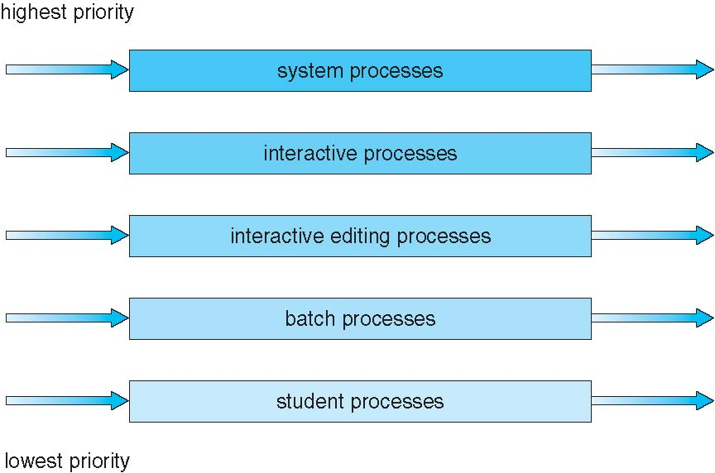
Multilevel Queue Scheduling

Slide 33
Multilevel Feedback Queue
A process can move between the various queues; aging can be implemented this way
Multilevel-feedback-queue scheduler defined by the following parameters:
number of queues
scheduling algorithms for each queue
method used to determine when to upgrade a process
method used to determine when to demote a process
method used to determine which queue a process will enter when that process needs service

Slide 34
Example of Multilevel Feedback Queue
Three queues:
Q₀ – RR with time quantum 8 milliseconds
Q₁ – RR time quantum 16 milliseconds
Q₂ – FCFS
Scheduling
A new job enters queue Q₀ which is served FCFS. When it gains CPU, job receives 8 milliseconds. If it does not finish in 8 milliseconds, job is moved to queue Q₁.
At Q₁ job is again served FCFS and receives 16 additional milliseconds. If it still does not complete, it is preempted and moved to queue Q₂.

Slide 35

Multilevel Feedback Queues

Slide 36
Multiple-Processor Scheduling
CPU scheduling more complex when multiple CPUs are available
Homogeneous processors within a multiprocessor
Asymmetric multiprocessing – only one processor accesses the system data structures, alleviating the need for data sharing
Symmetric multiprocessing (SMP) – each processor is self-scheduling, all processes in common ready queue, or each has its own private queue of ready processes
Processor affinity – process has affinity for processor on which it is currently running
soft affinity
hard affinity

Slide 37
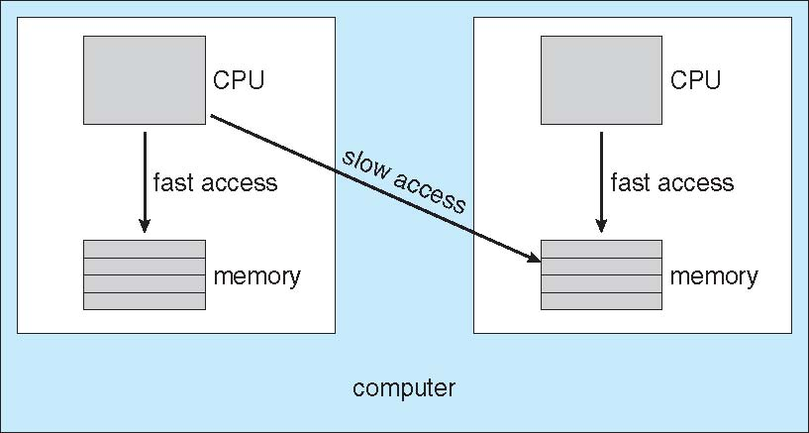
NUMA and CPU Scheduling

Slide 38
Multicore Processors
Recent trend to place multiple processor cores on same physical chip
Faster and consume less power
Multiple threads per core also growing
Takes advantage of memory stall to make progress on another thread while memory retrieve happens

Slide 39
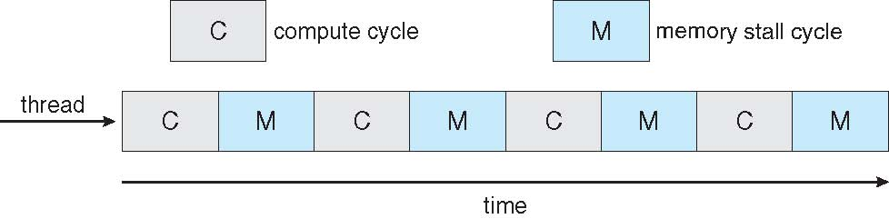
Multithreaded Multicore System

Slide 40
Operating System Examples
Solaris scheduling
Windows XP scheduling
Linux scheduling

Slide 41
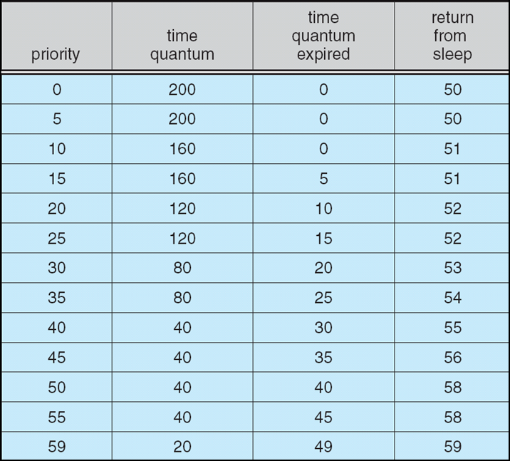
Solaris Dispatch Table

Slide 42
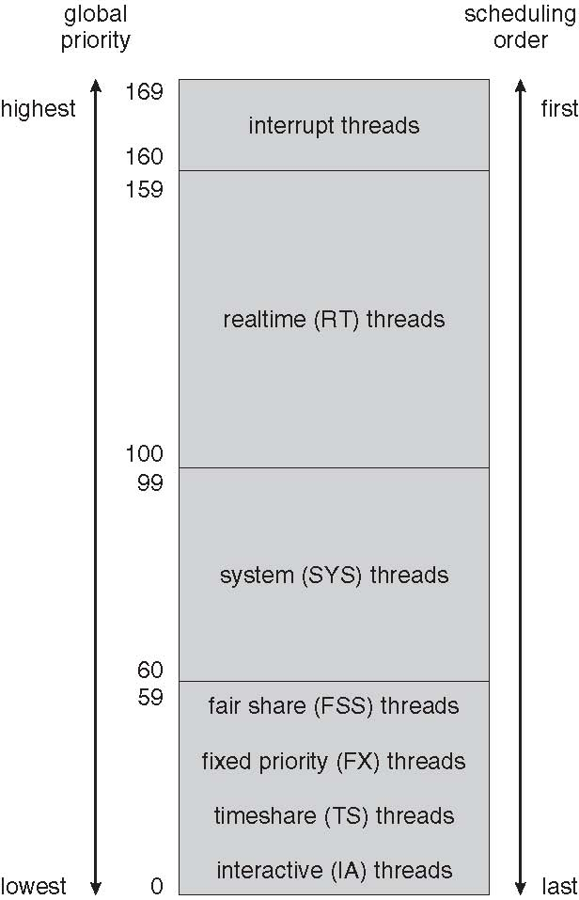
Solaris Scheduling

Slide 43
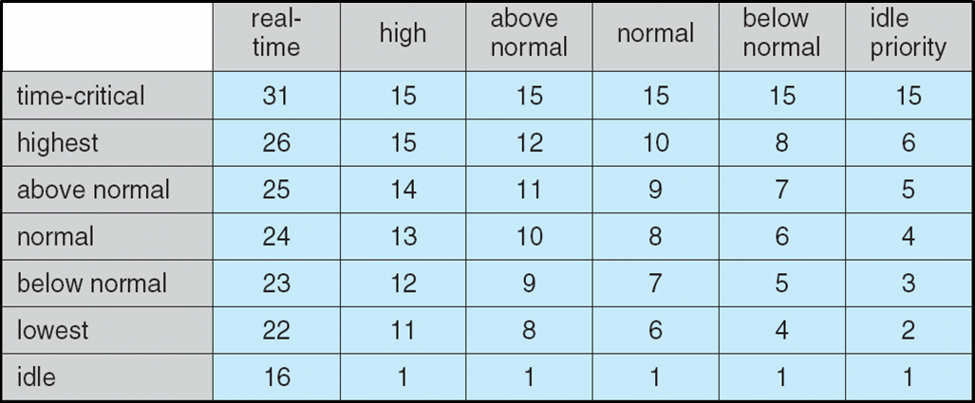
Windows XP Priorities

Slide 44
Linux Scheduling
Constant order O(1) scheduling time
Two priority ranges: time-sharing and real-time
Real-time range from 0 to 99 and nice value from 100 to 140
(figure 5.15)

Slide 45
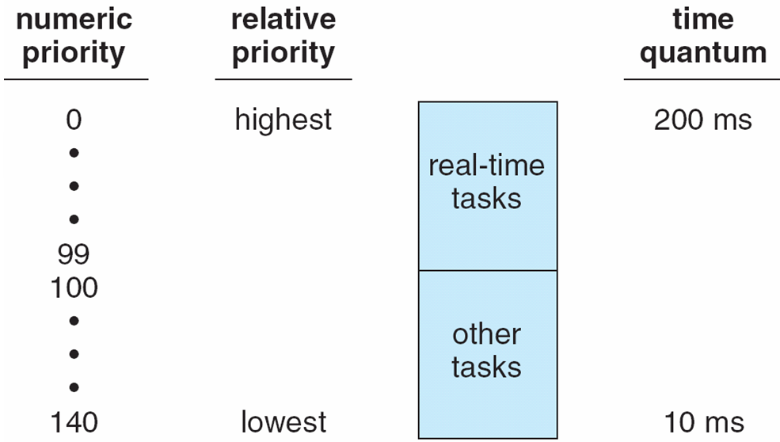
Priorities and Time-slice length

Slide 46
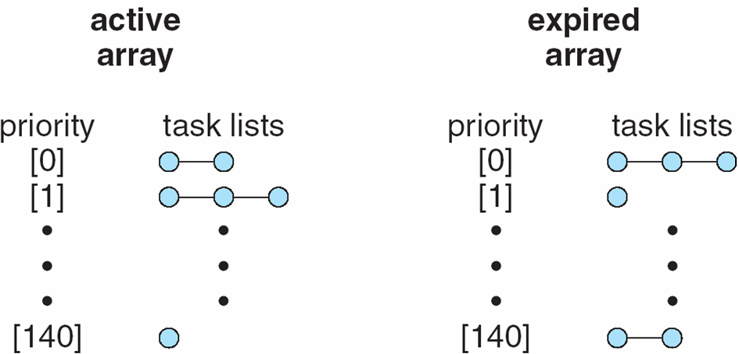
List of Tasks Indexed According to Priorities

Slide 47
Algorithm Evaluation
Deterministic modeling – takes a particular predetermined workload and defines the performance of each algorithm for that workload
Queueing models
Implementation

Slide 48
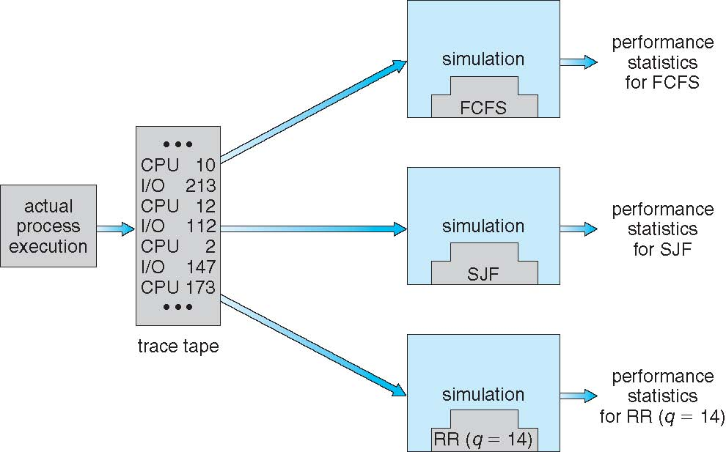
Evaluation of CPU schedulers by Simulation

Slide 49
End of Chapter 5

Slide 50
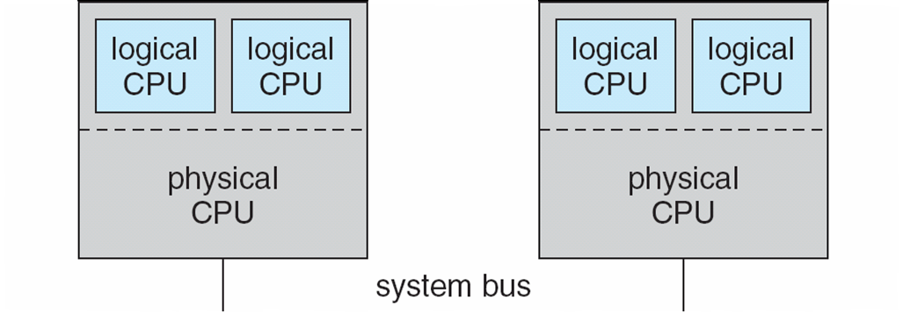
5.08

Slide 51
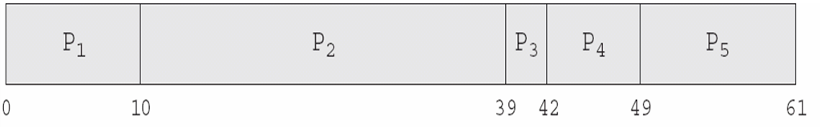
In-5.7

Slide 52
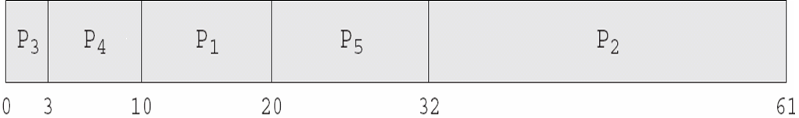
In-5.8

Slide 53
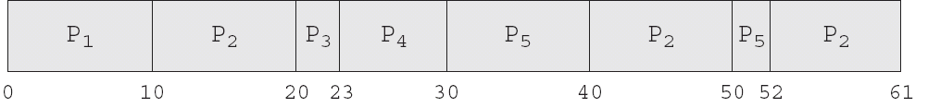
In-5.9

Slide 54
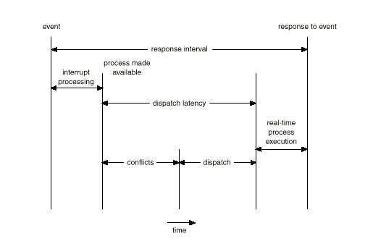
Dispatch Latency

Slide 55
Java Thread Scheduling
JVM Uses a Preemptive, Priority-Based Scheduling Algorithm
FIFO Queue is Used if There Are Multiple Threads With the Same Priority

Slide 56
Java Thread Scheduling (Cont.)
JVM Schedules a Thread to Run When:
The Currently Running Thread Exits the Runnable State
A Higher Priority Thread Enters the Runnable State
* Note – the JVM Does Not Specify Whether Threads are Time-Sliced or Not

Slide 57
Time-Slicing
Since the JVM Doesn’t Ensure Time-Slicing, the yield() Method May Be Used:
while (true) {
// perform CPU-intensive task
. . .
Thread.yield();
}
This Yields Control to Another Thread of Equal Priority

Slide 58
Thread Priorities
Priority Comment
Thread.MIN_PRIORITY Minimum Thread Priority
Thread.MAX_PRIORITY Maximum Thread Priority
Thread.NORM_PRIORITY Default Thread Priority
Priorities May Be Set Using setPriority() method:
setPriority(Thread.NORM_PRIORITY + 2);

Slide 59
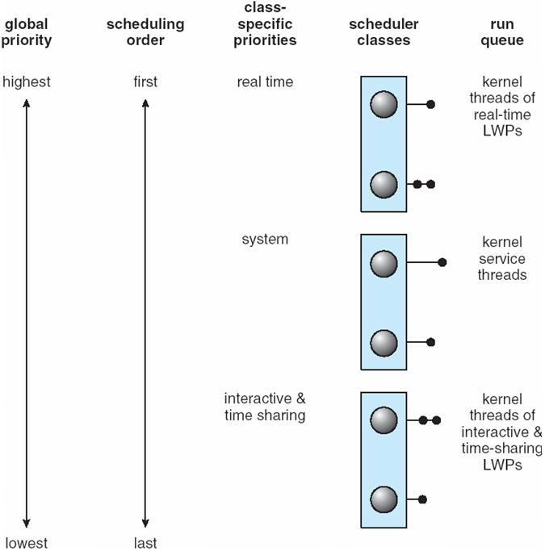
Solaris 2 Scheduling

